Slide 1
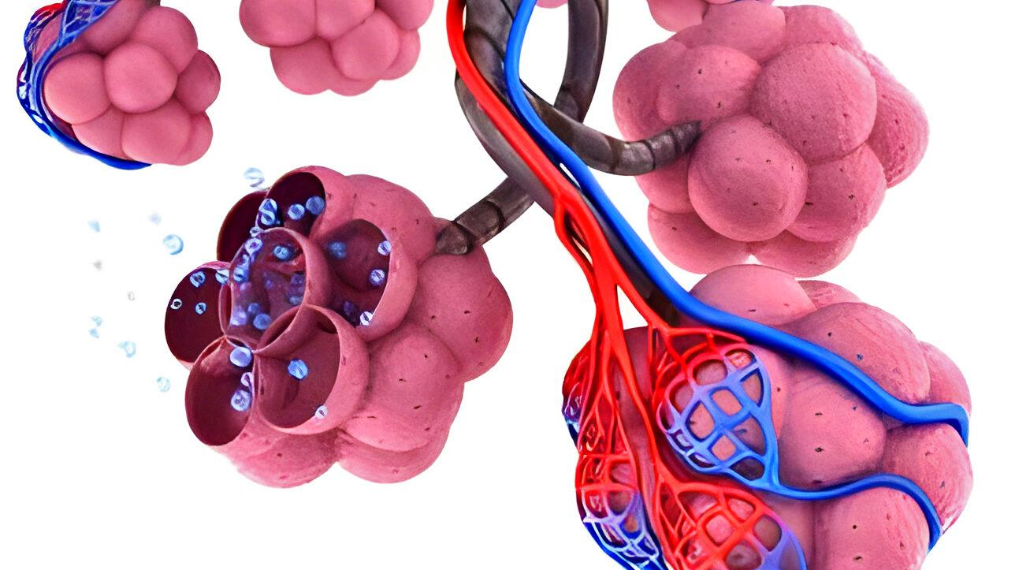

BREATHING AND EXCHANGE OF GASES

Slide 2
What is respiration??
Oxygen from the atmosphere is taken inside and carbon dioxide produced is taken out. This process of gaseous exchange is called breathing or respiration.

Slide 3
Respiratory organs
Through body surface- poriferans, coelenterates, flatworms
Moist cuticle- Earthworms
Moist skin- Amphibians (frogs)
Tracheal network - Arthropods (cockroaches)
Gills- Aquatic animals- arthropods, mollusks and fishes
Lungs- Terrestrial vertebrates including human

Slide 4
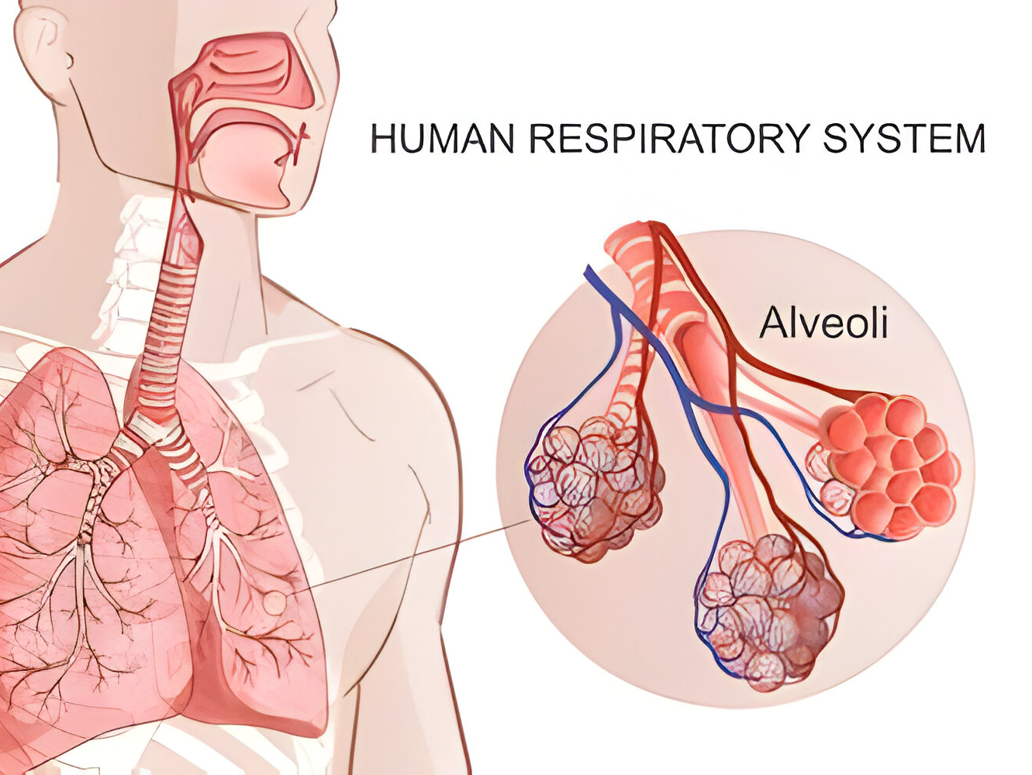
Human Respiratory System

Slide 5
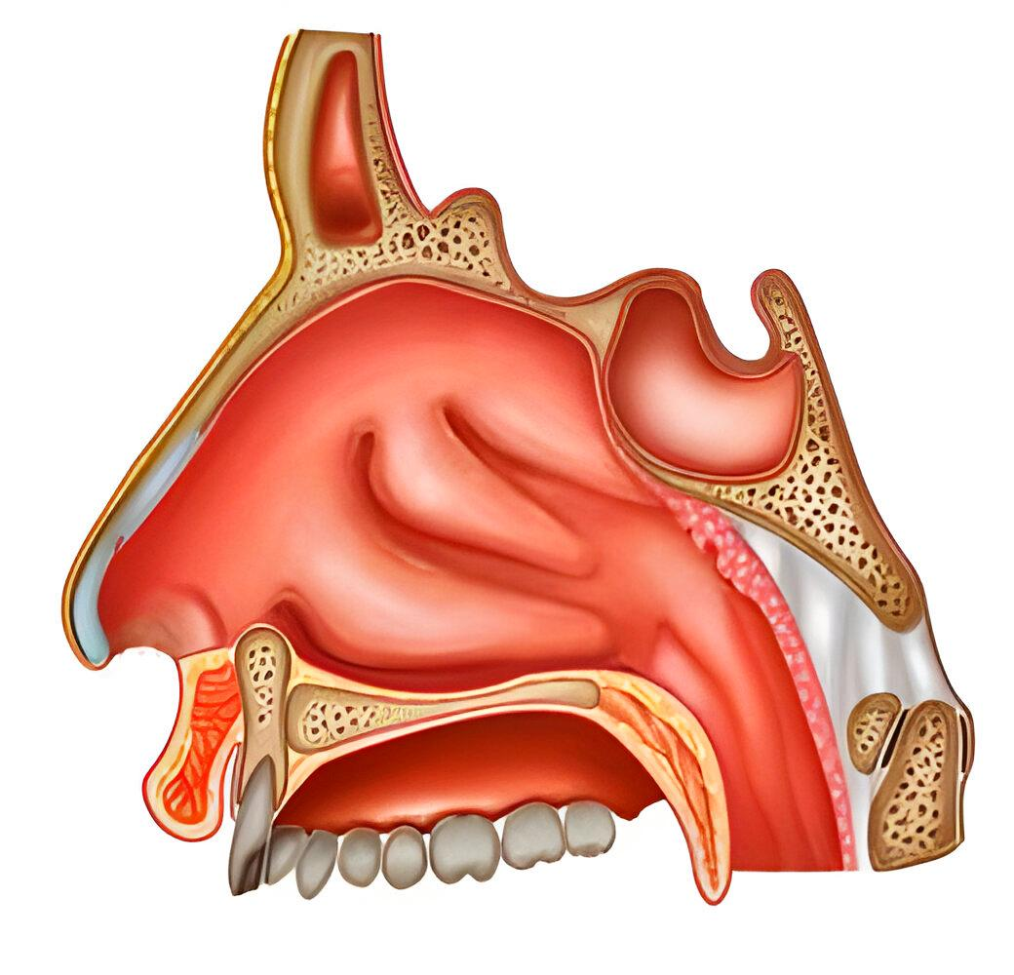
Nostrils, Nasal passage and Nasal cavity

Slide 6
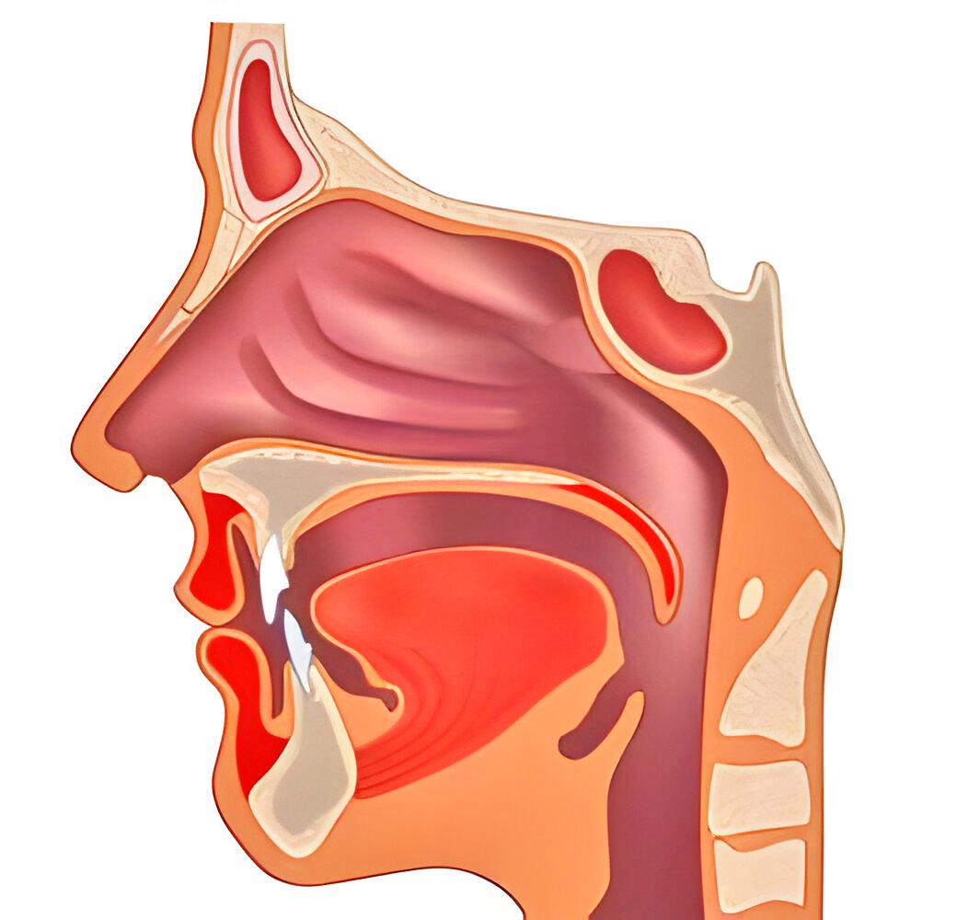
PHARYNX

Slide 7
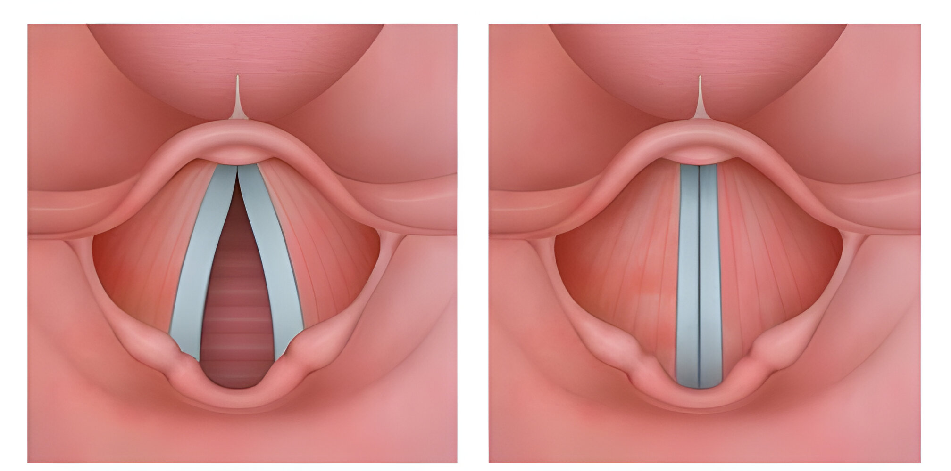
Glottis and Epiglottis

Slide 8
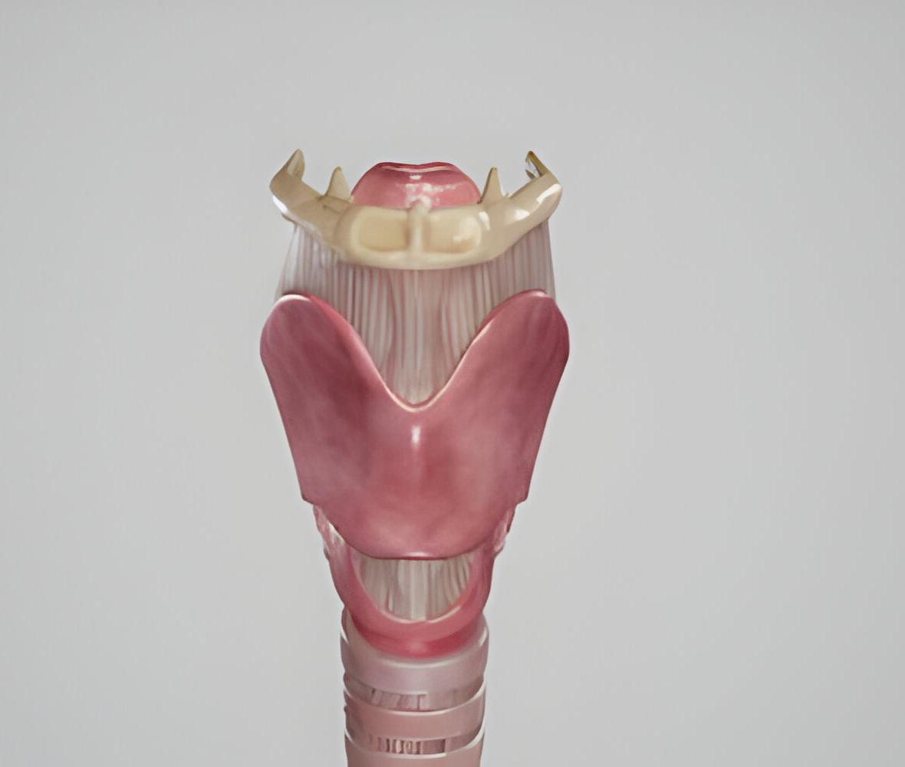
LARYNX

Slide 9
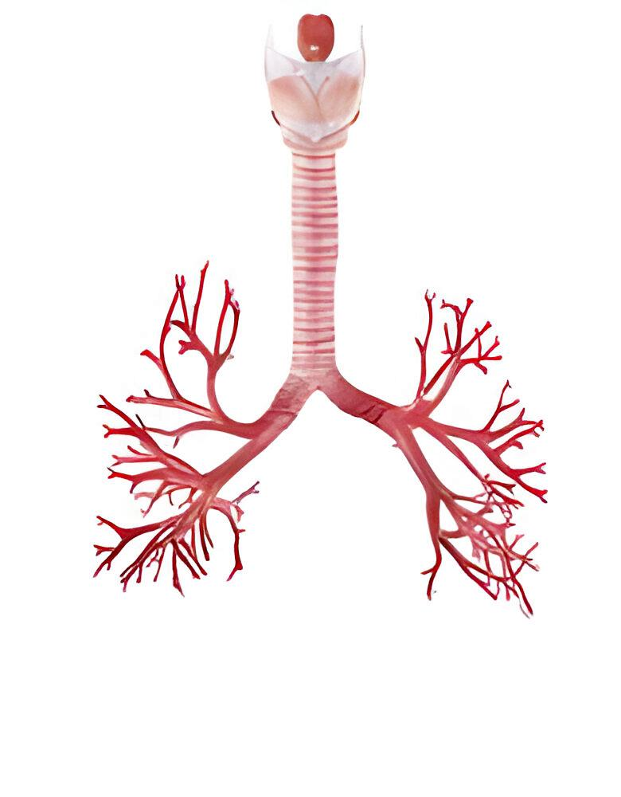
Trachea , bronchi and bronchioles

Slide 10
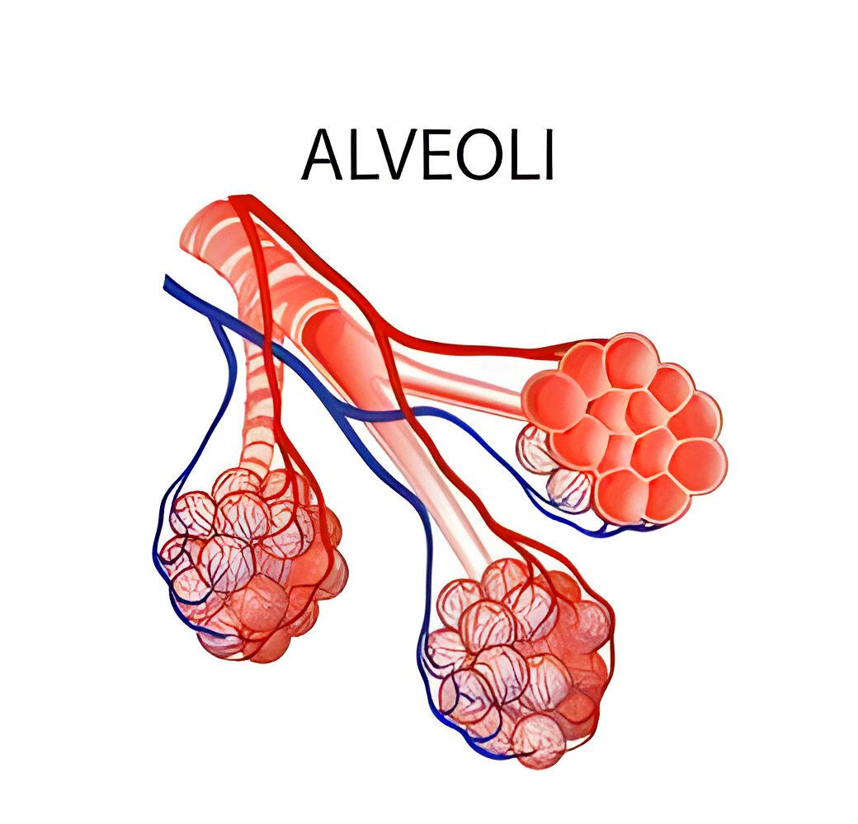
Alveoli

Slide 11
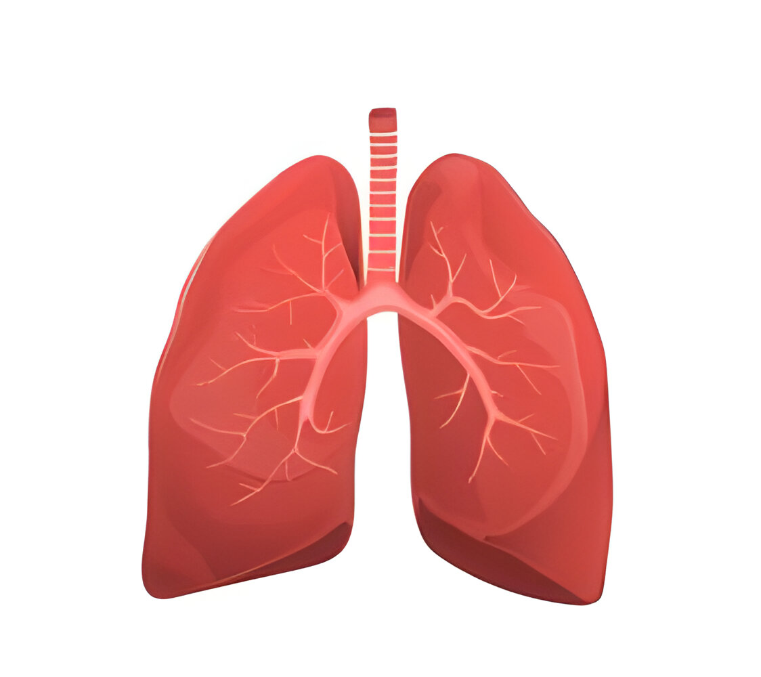
LUNGS

Slide 12
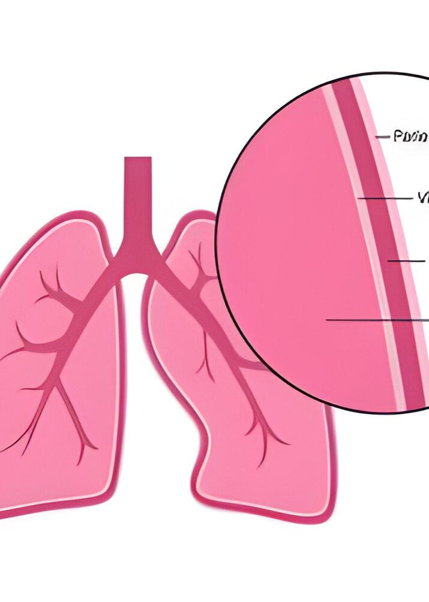
PLEURA AND PLEURAL FLUID

Slide 13
Conducting part of the respiratory system:
NOSTRILS TO TERMINAL BRONCHIOLES
Nostrils → Pharynx → Larynx → Trachea → Primary Bronchi (Right and left) → Secondary and tertiary bronchi → Bronchioles → Terminal bronchiole

Slide 14
Conducting part of the respiratory system: Functions

Slide 15
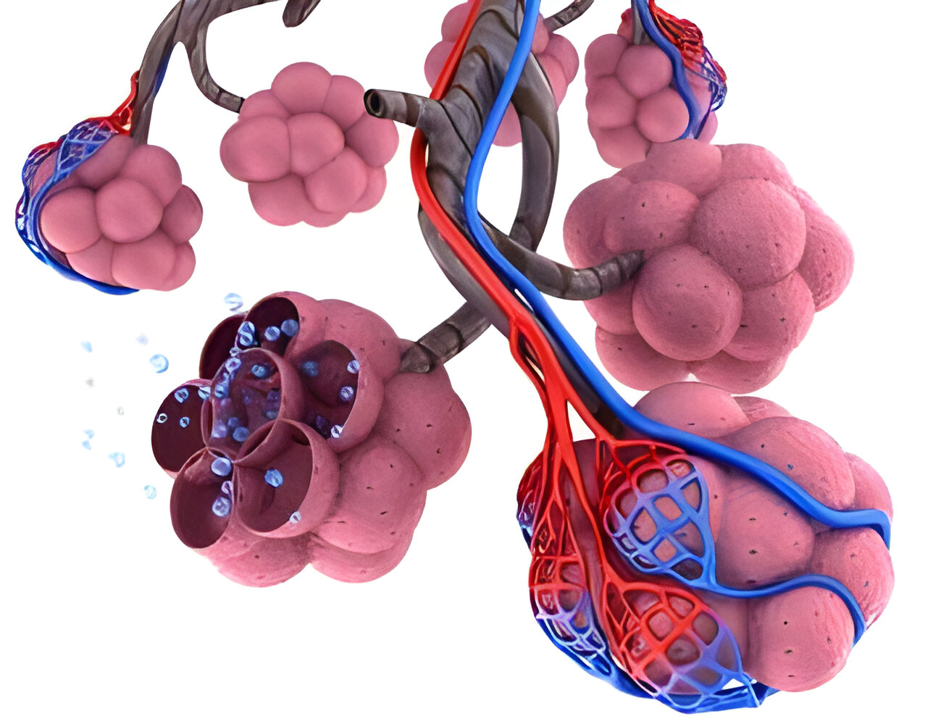
Exchanging part of the respiratory system : Alveoli and alveolar ducts

Slide 16
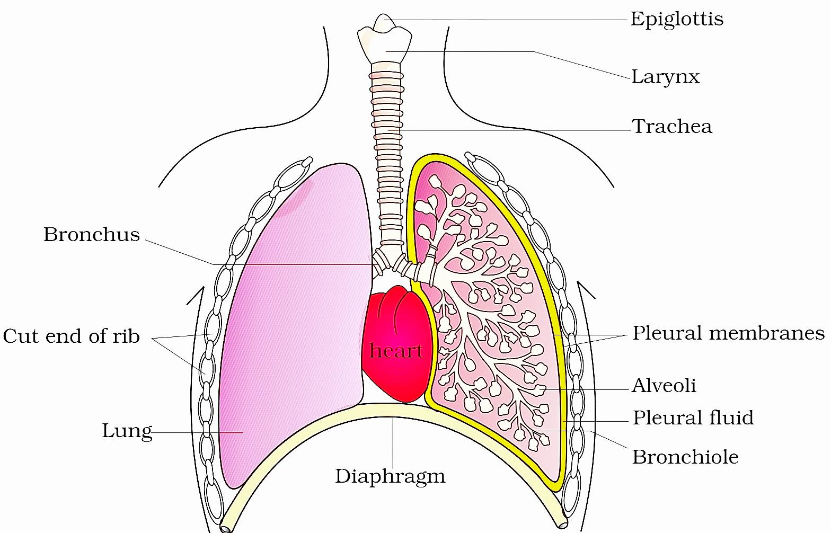

Slide 17
Process of respiration
Pulmonary Ventilation
Diffusion of O2 and CO2 across the alveolar membrane
Transportation of gases by blood
Diffusion of O2 and CO2 between blood and tissue
Cellular respiration

Slide 18
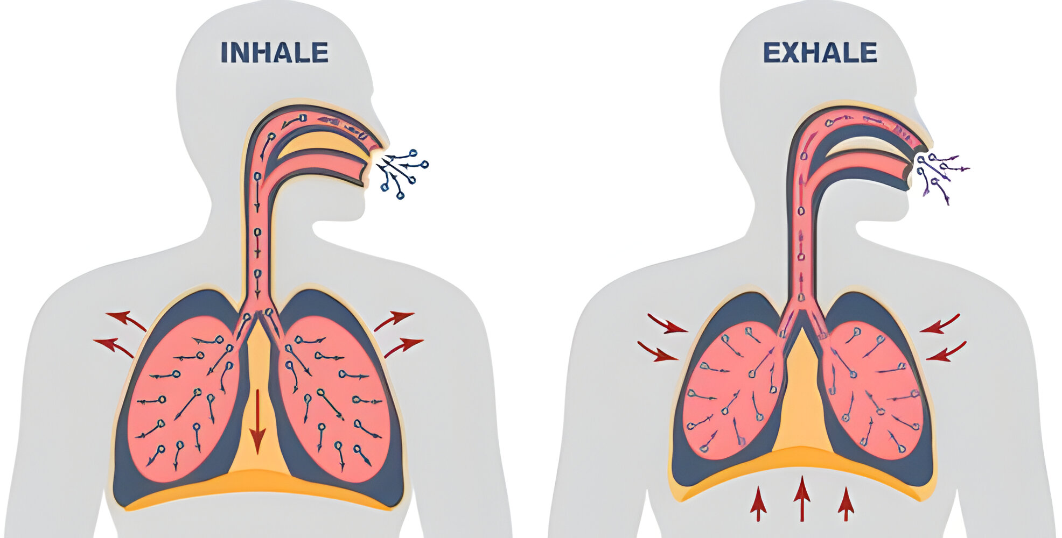
Breathing Mechanism
Inspiration: Atmospheric air is taken inside
Expiration: Alveolar air is expelled out

Slide 19
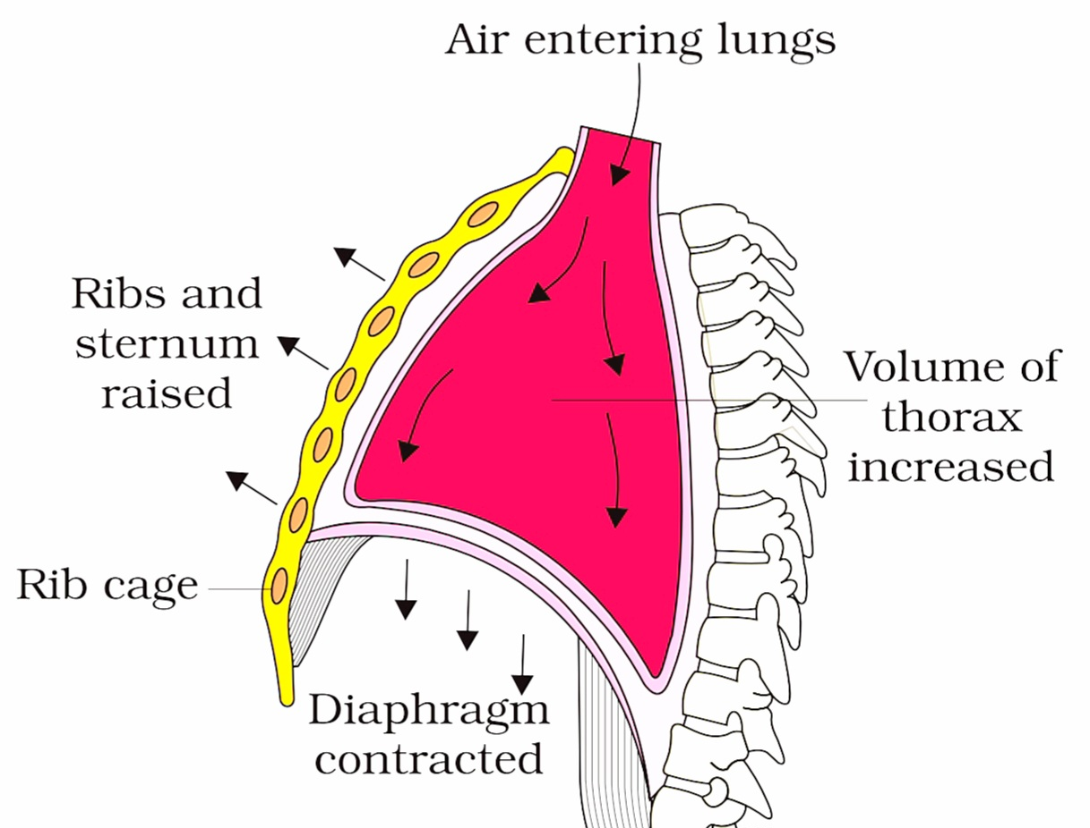
MECHANISM OF INSPIRATION

Slide 21
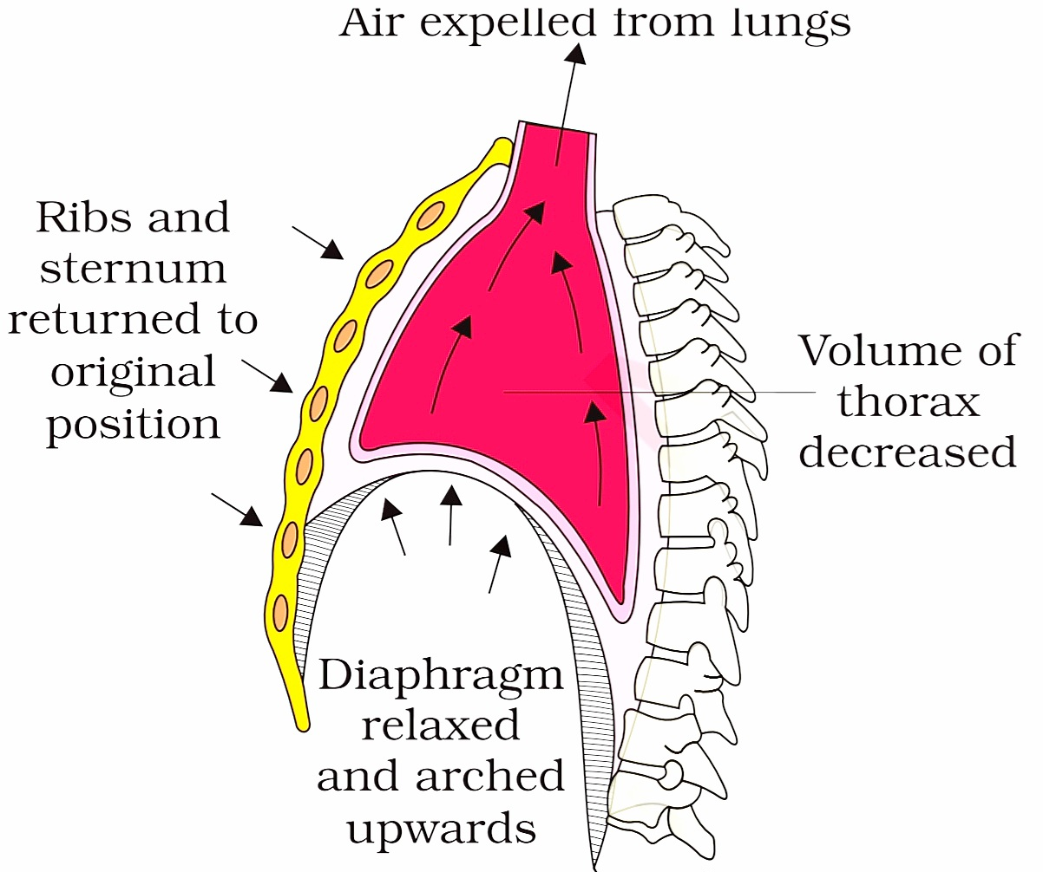
MECHANISM OF EXPIRATION

Slide 23
Normal breathing rate is 12-16 times/ minute.
Spirometer- An apparatus for measuring the volume of inhaled and exhaled air.

Slide 24
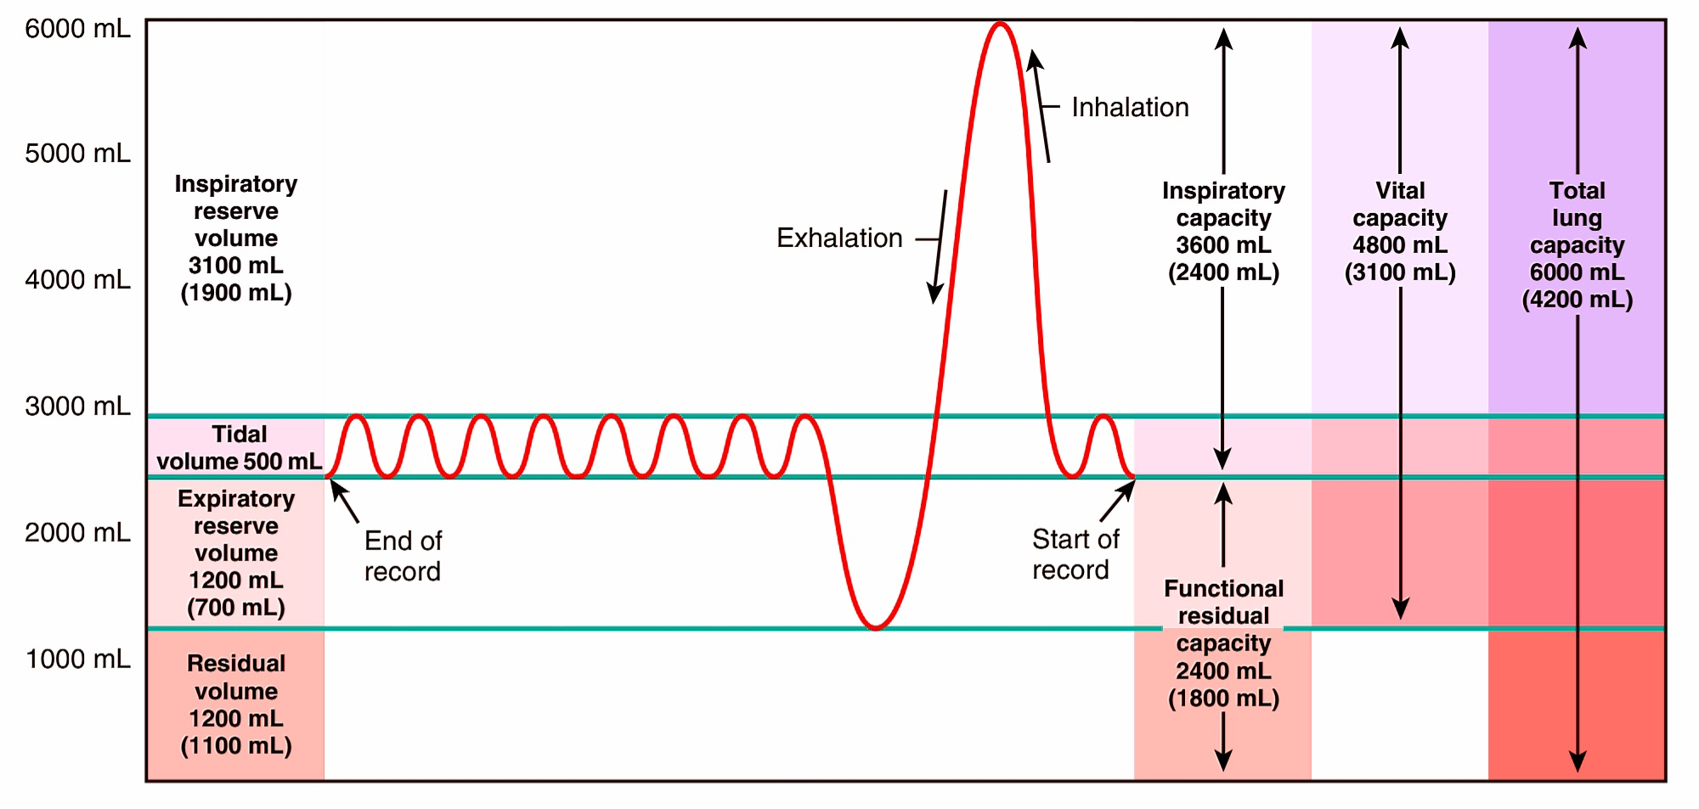
Respiratory Volumes and Capacities

Slide 25
.
Tidal volume (TV)- 500 ml, the volume of air inspired or expired normally

Slide 26
Inspiratory reserve volume (IRV)- 2500 to 3000 ml, additional air by forcible inspiration.

Slide 27
Expiratory reserve volume (ERV)- 1000 to 1100 ml, additional air by forcible expiration.

Slide 28
Residual volume (RV)- 1100 to 1200 ml, the air in the lungs after forcible expiration.

Slide 29
Inspiratory Capacity
The inspiratory capacity is the total volume of air that can be inspired after normal expiration
IC = TV + IRV

Slide 30
Expiratory Capacity
The expiratory capacity is the total volume of air that can be expired after normal inspiration
EC = TV + ERV

Slide 31
The functional residual capacity:
It is the total volume of air residing within the lungs after an exhalation process
FRC = ERV + RV

Slide 32
Vital Capacity
The vital capacity is the total volume of air that can be expired after a maximum inhalation or maximum air that a person can breathe in after forced expiration
VC = TV + ERV + IRV

Slide 33
Total Lung capacity
Total volume of air-filled in the lungs after a forced inspiration.
TLC = TV + ERV + IRV + RV

Slide 35
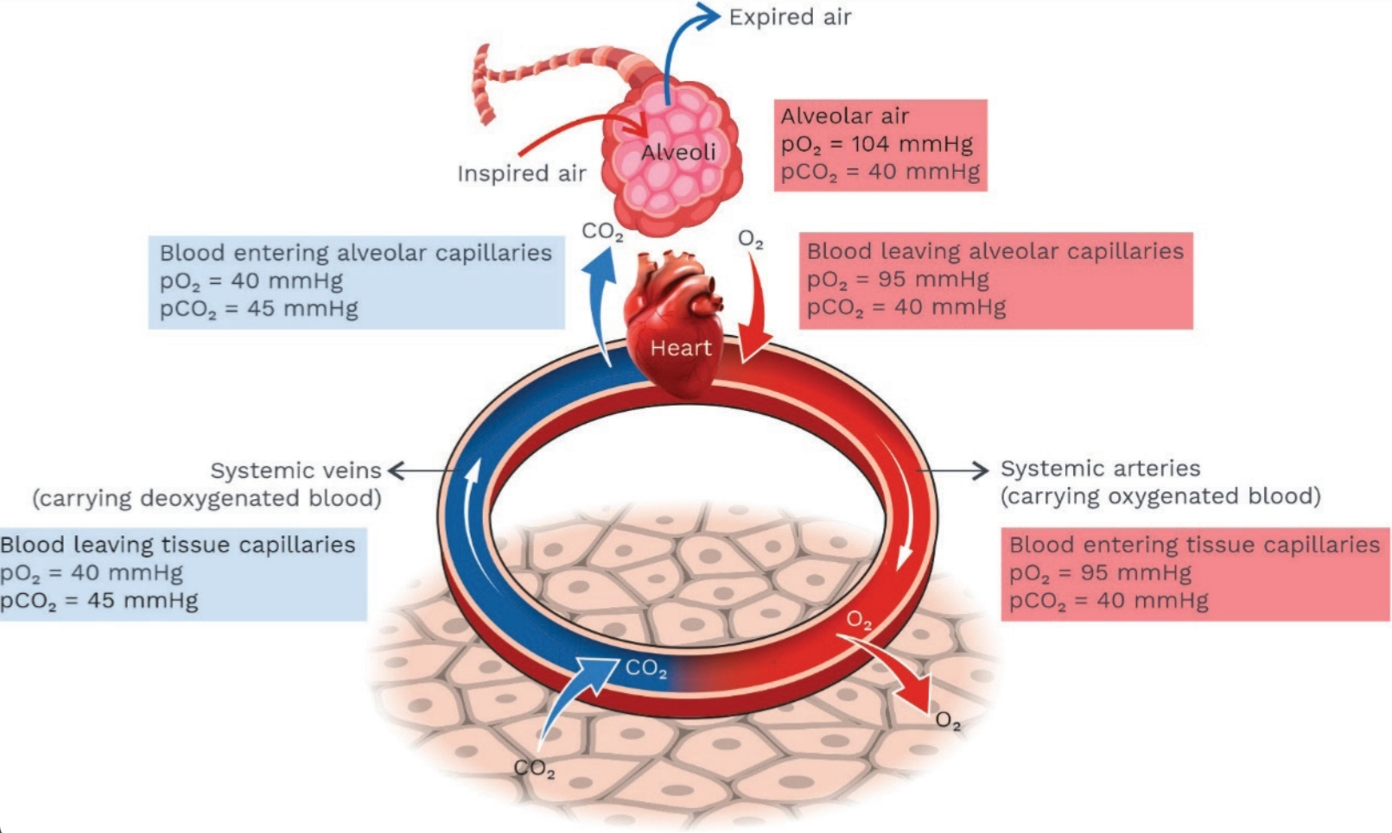
Exchange of Gases

Slide 36
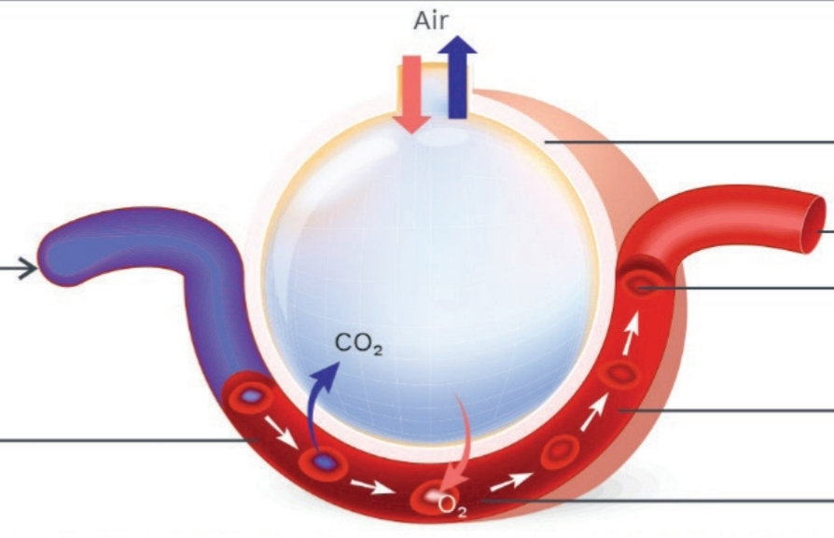
Exchange of Gases
The simple diffusion process is the reason behind the exchange of gases.
The difference between partial pressure determines the movement of the air from one place to another.

Slide 37
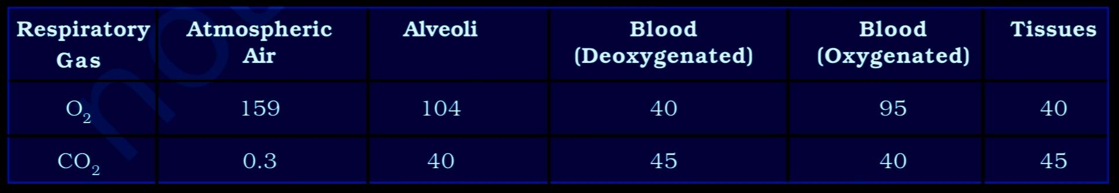
Factors effecting exchange of gases
  Partial pressure: The individual gas pressure

Slide 38
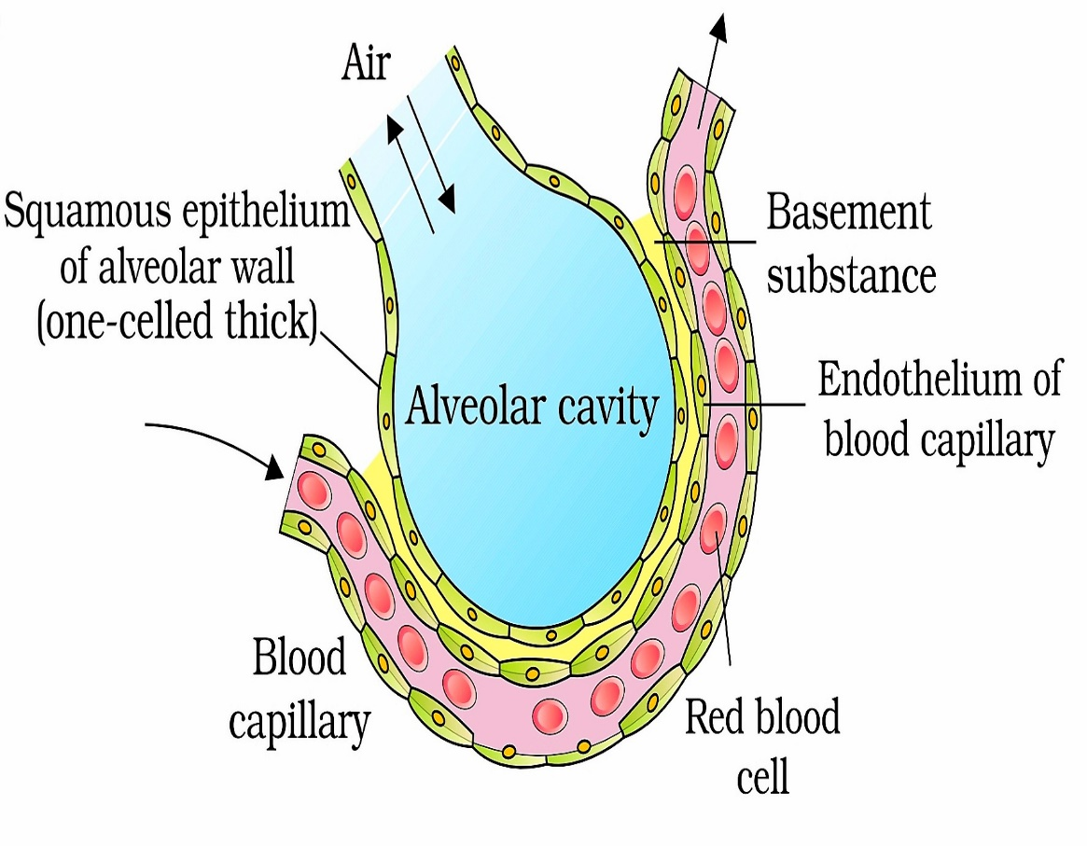
Factors effecting exchange of gases
Thickness of diffusion membrane:
Three layers make up the diffusion layer of alveoli:
  Thin squamous epithelium.
  Endothelium.
  Basement membrane.

Slide 39
Factors effecting exchange of gases
Solubility:
Solubility of CO2 is 25 times as that of O2

Slide 40
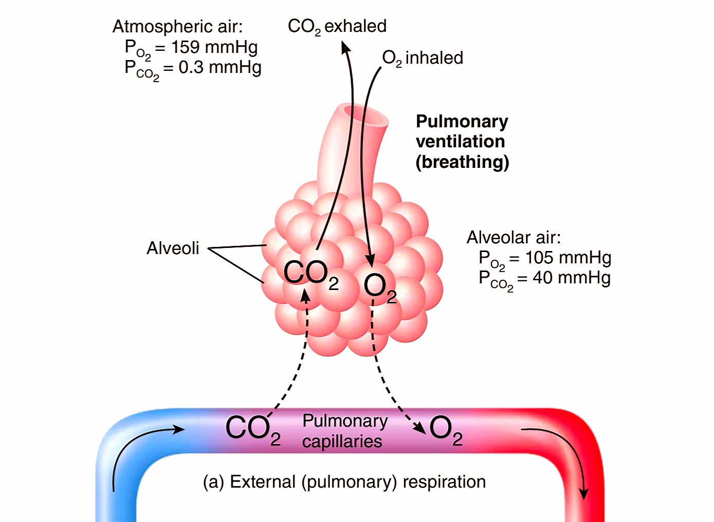
Exchange of gases – Alveolar region

Slide 41
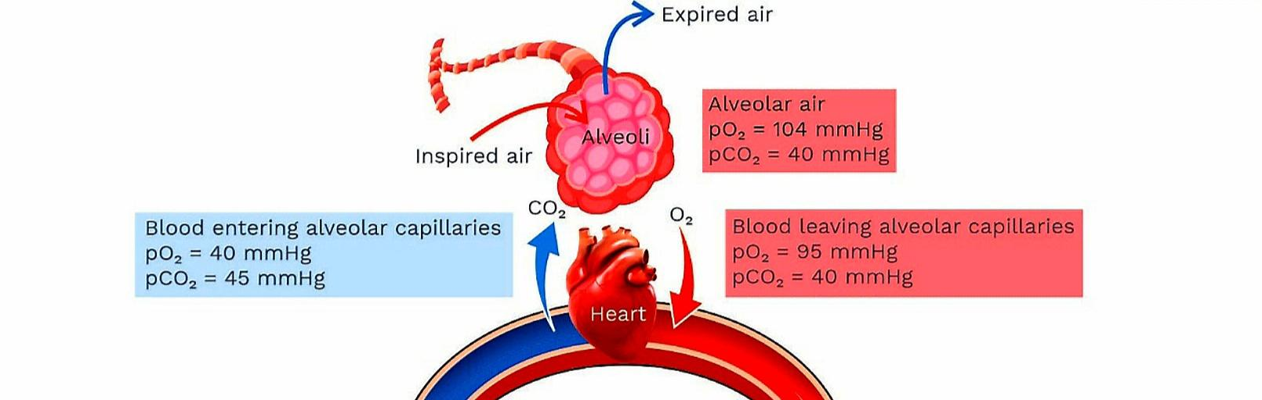

Slide 42
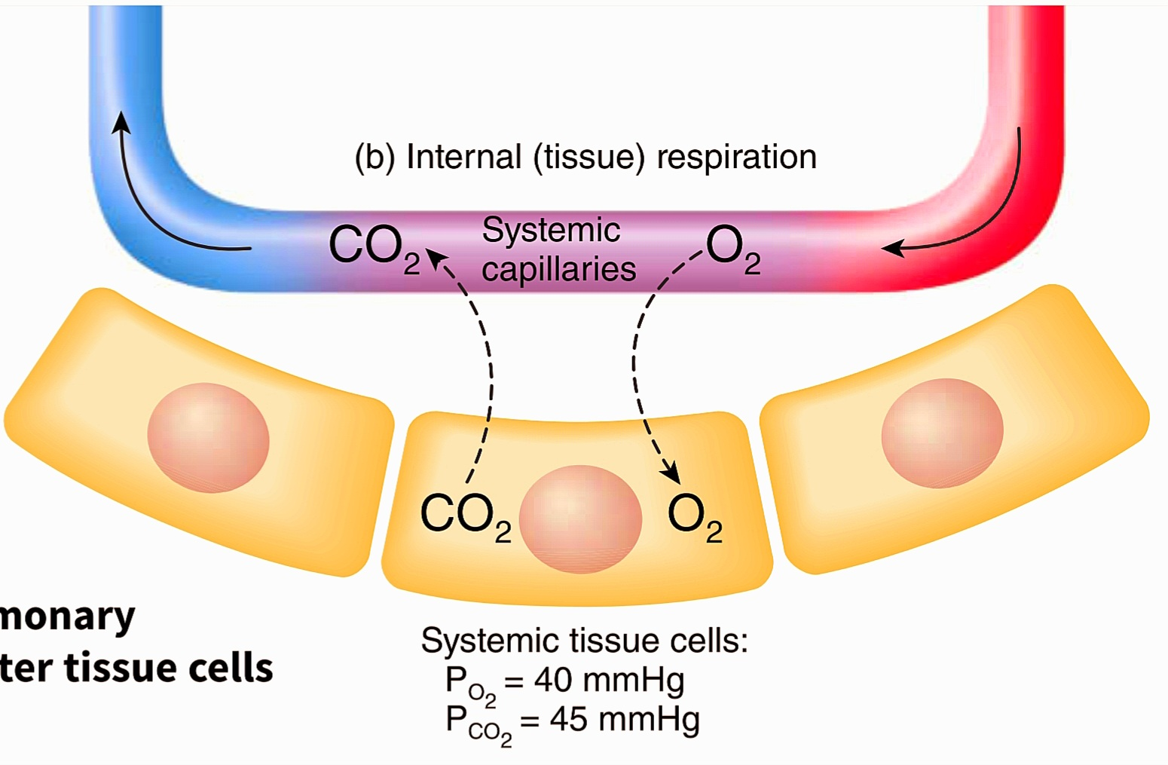
Exchange of gases – Tissue region

Slide 43
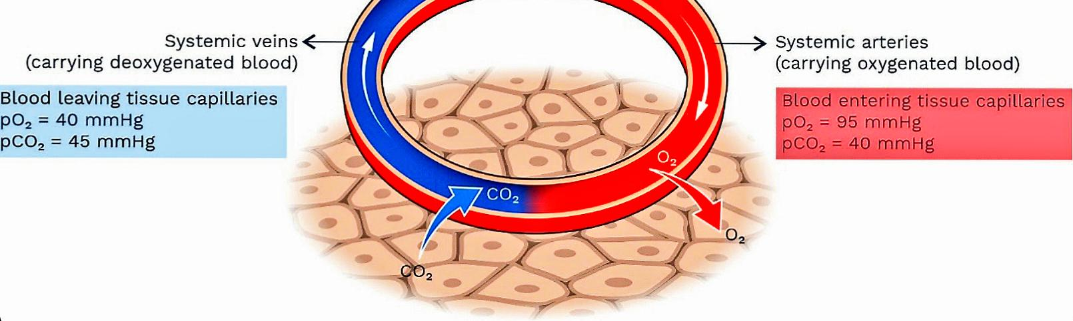

Slide 44
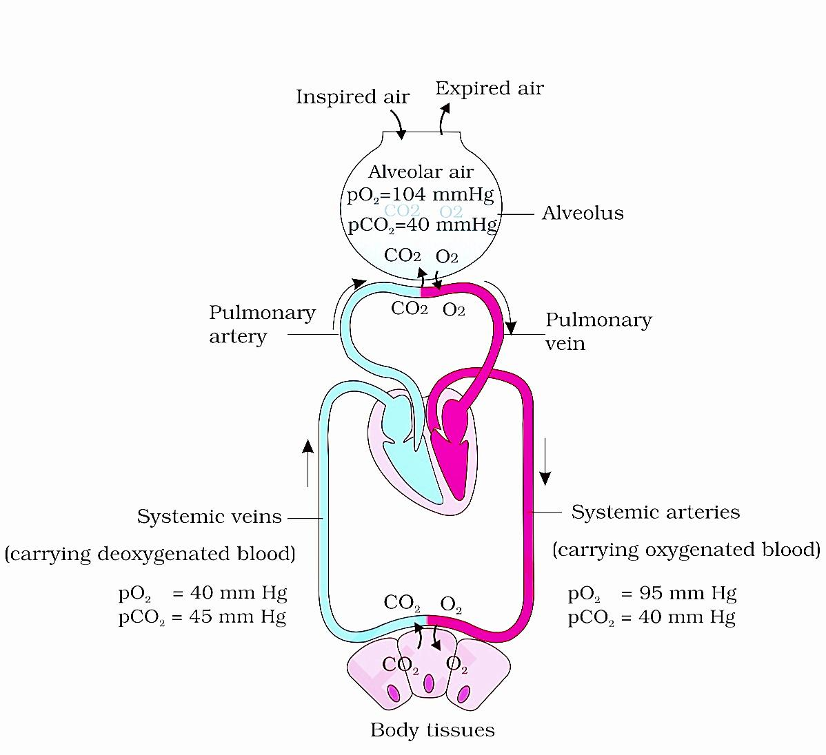

Slide 45
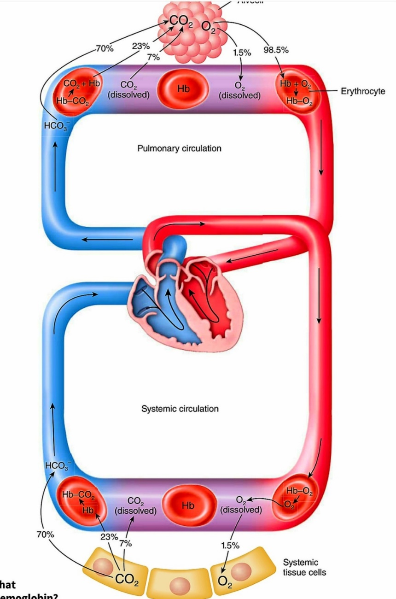
Transport of Gases

Slide 46
Transport of oxygen
As Oxy hemoglobin
97%
RBC
Dissolved state
3%
Plasma

Slide 47
As oxyheamoglobin
One molecule of hemoglobin binds with four oxygen molecules. This binding depends upon:
  The partial pressure of oxygen
  The partial pressure of carbon dioxide
  H+ ion concentration
  Temperature

Slide 48
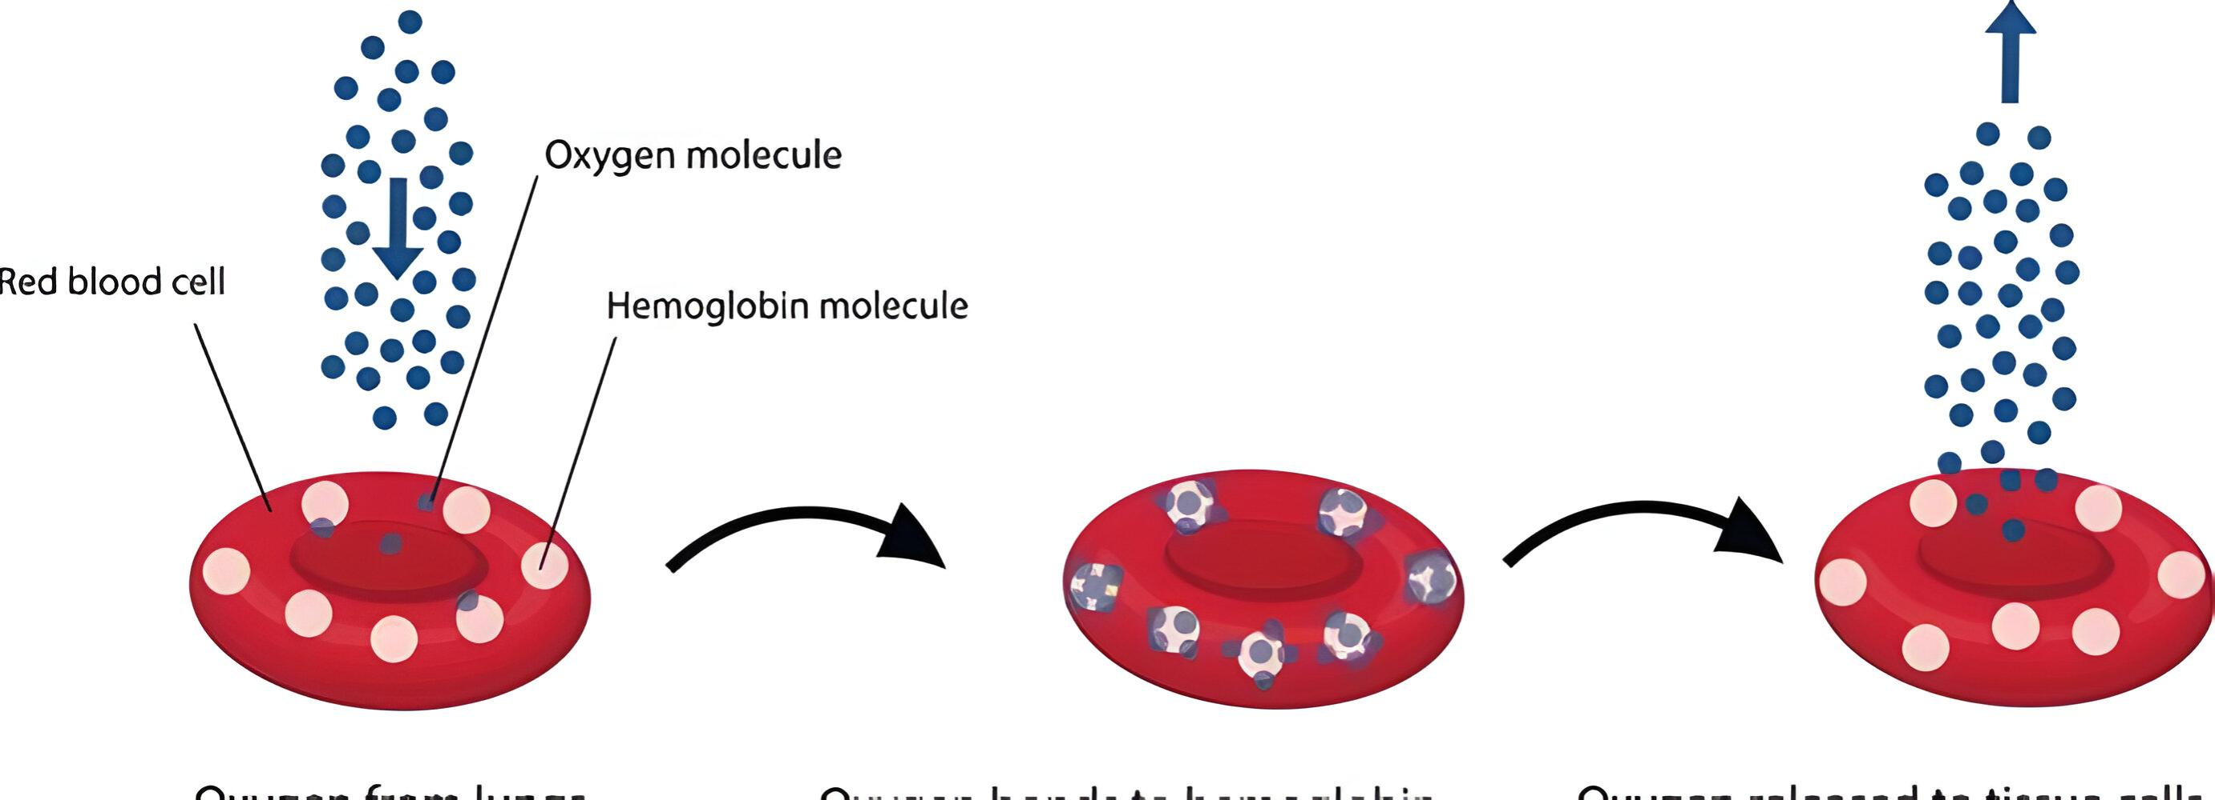

Slide 49
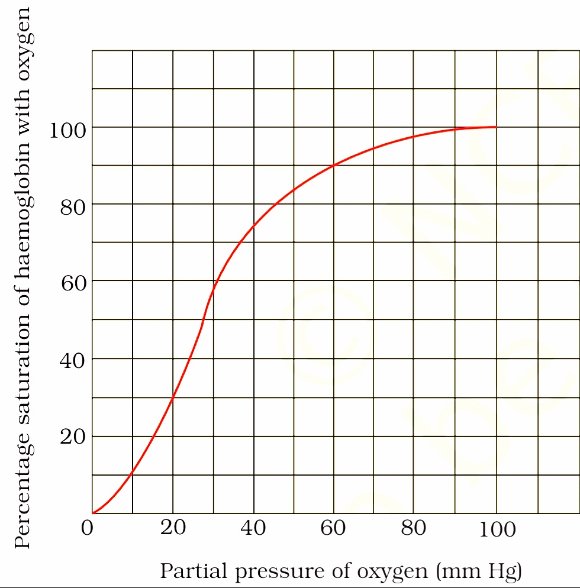
Oxygen dissociation curve: The percentage saturation of hemoglobin is plotted against the partial oxygen.

Slide 50
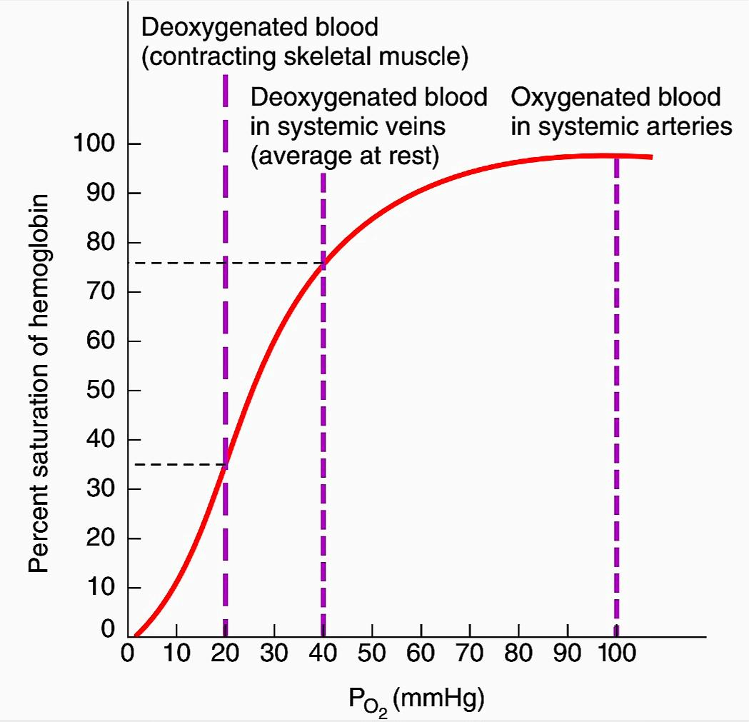

Slide 51
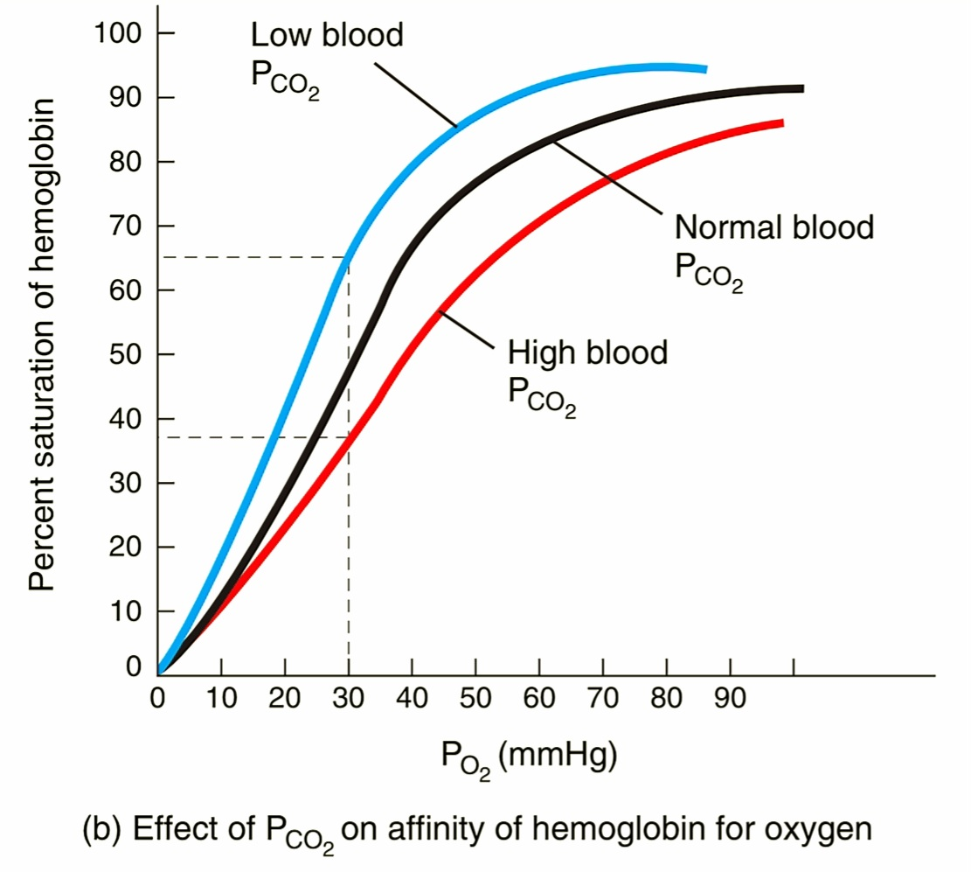
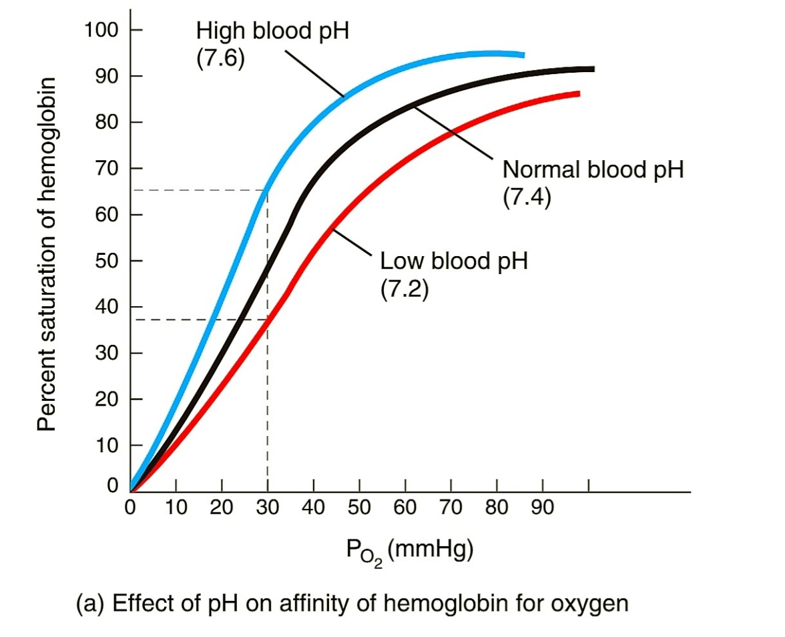

Slide 52
Transport of Carbondioxide
7%
As dissolved state through plasma
20-25%
As Carbaminohemoglobin
70%
As bicarbonate

Slide 53
As Carbaminohemoglobin

Slide 54
As Bicarbonate Ione

Slide 55
Regulation of Respiration
The neural system is the system that has the control of respiration.
In the medulla region in the brain, there is a respiratory rhythm centre responsible for respiration regulation.
In the pons region of the brain, there are also Pneumotaxic centres present.
There is a chemo sensitive area adjacent to the rhythmic centre, which is highly sensitive to CO2 and H+ ion concentration.

Slide 56
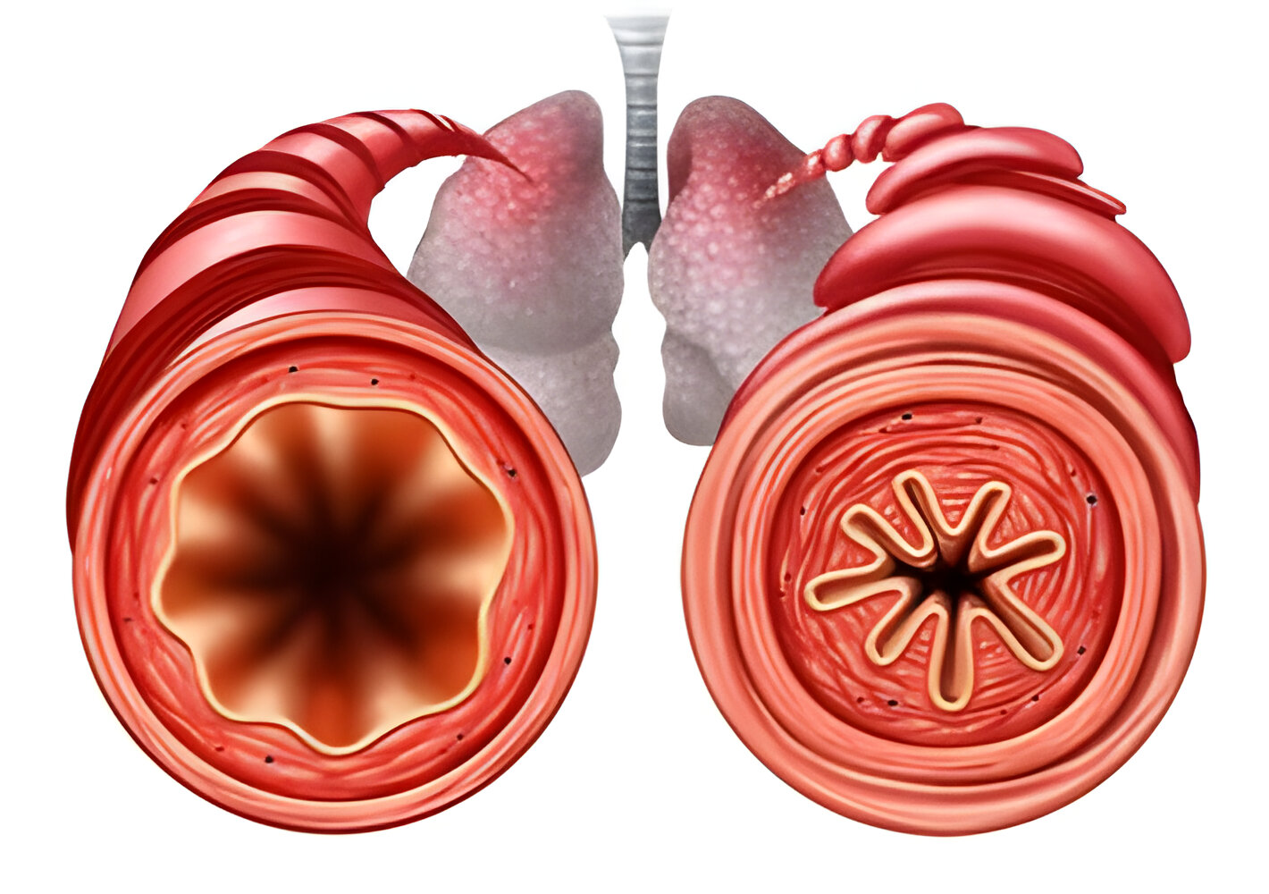
Disorders of Respiration
Asthma: When there is an inflammation of bronchi and bronchioles, it is known as asthma. Asthma causes wheezing and difficulty in breathing.

Slide 57
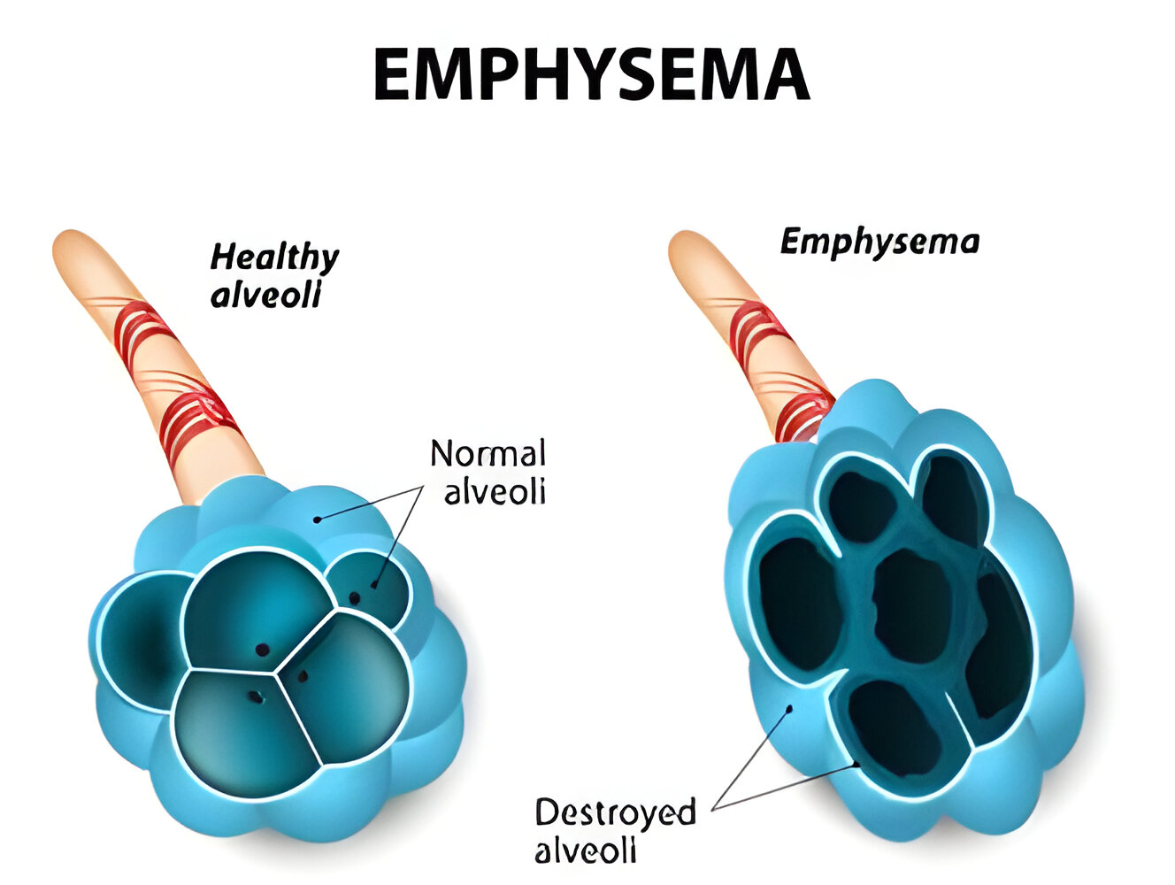
Emphysema: In this condition, alveolar walls get damaged, and as a result, the respiratory surface is decreased. It is a chronic disorder.

Slide 58
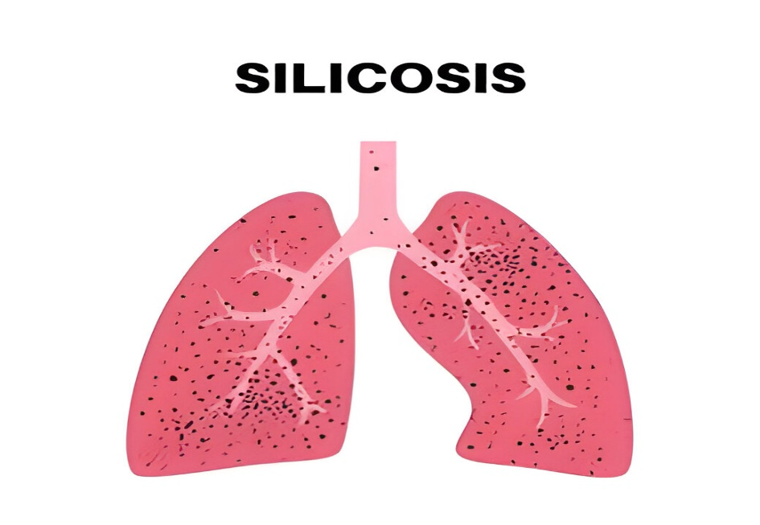
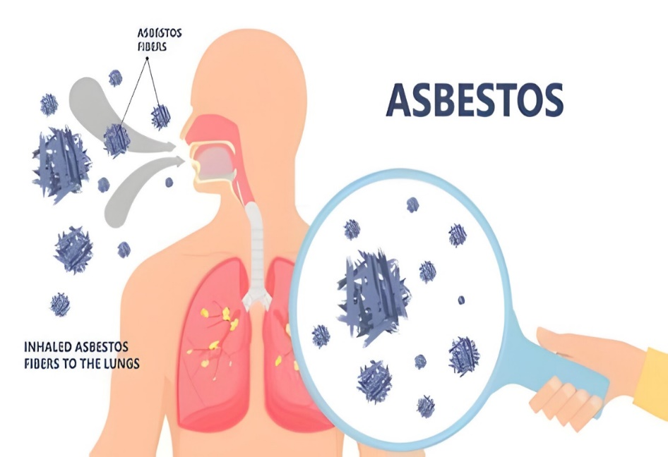
Occupational respiratory disorder:
  Fibrosis and excess mucus in the lungs is caused due to long-term exposure to dust.
  This kind of disorder is seen usually in people involved in stone breaking and grinding.

Slide 59
Class Assignment
Which of the following are the respiratory organs of insects?
1. Tracheal tubes 2. Gills
3. Cuticle 4. Lungs
Intercostal muscles are found attached with
1. Diaphragm 2. Ribs
3. Pleura 4. Lungs
The alveoli of lungs are lined by
1. Simple epithelium 2. Squamous epithelium
3. Cuboidal epithelium 4. Columnar epithelium

Slide 60
4. The partial pressure of oxygen om the alveolar air is
1. 45mm Hg 2. 95mm Hg
3. 104mm Hg 4. 110mm Hg
5. Pneumotaxic centre of the brain can
1. Moderate the function of respiratory system
2. Decrease the heart rate
3. Increase the heart rate
4. Increase the flow of blood
6. Cigarette smoking is major cause of
1. Pneumonia 2. Emphysema
3. Asthma 4. Occupational lung disease

Slide 61
7. “Epiglottis” is made up by
1. Elastic cartilage 2. Fibrous cartilage
3. Hyaline cartilage 4. Bony structure
8. Which one has the lowest value?
1. tidal volume 2. Vital capacity
3. Inspiratory reserve volume 4. Expiratory reserve volume
9. Tidal volume and expiratory reserve volume are collectively known as
1. Inspiratory capacity 2. Vital Capacity
3. Expiratory capacity 4. Functional residual capacity

Slide 62
10. Partial pressure of carbon dioxide in Alveoli, atmospheric air and tissues will be
1. (0.3, 40, 45) mmHg 2. (40, 0.3, 45) mmHg
3. (0.3, 104, 28) mmHg 4. (104, 159, 40) mmHg
11. Under normal condition 100ml blood deliver ______ to tissue.
1.4ml O₂ 2. 10ml O₂ 3. 5ml O₂ 4. 25ml O₂
12. In which part of lungs gaseous exchange takes place in human
1. Trachea & alveolar duct 2. Trachea & bronchi
3. Alveolar duct & alveoli 4. Alveoli & Trachea

Slide 63
13. Match the columns
Column I | Column II
(a) Larynx | (p) Lid of glottis
(b) Trachea | (q) Air Sac
(c) Alveoli | (r) Voice Box
(d) Epiglottis | (s) Wind Pipe
 | (t) Common Passage
1. a-----r, b-----s, c-----q, d------p
2. a-----t, b-----s, c-----p, d------q
3. a-----r, b-----s, c-----q, d------t
4. a-----r, b-----t, c-----q, d------p

Slide 64
14. Match column I and Column II and choose option with correct match
1. A(i), B(vi), C(iv), D(iii), E(ii), F(v)
2. A(i), B(ii), C(iv), D(iii), E(v), F(vi)
3. A(i), B(ii), C(iv), D(v), E(vi), F(ii)
4. A(ii), B(iii), C(iv), D(v), E(vi), F(i)
Column I | Column II
(A) ERV | (i) 1000ml
(B) IRV | (ii) 1200ml
(C) TV | (iii) 2500ml
(D) FRC | (iv) 500ml
(E) EC | (v) 2300ml
(F) RV | (vi) 1500ml

Slide 65
15. Which of the following statements is not true?
1. The partial pressure of O₂ in deoxygenated blood is 40mm Hg.
2. The partial pressure of O₂ in oxygenated blood is 95mm Hg.
3. The partial pressure of O₂ in alveolar air is 104mm Hg.
4. The partial pressure of CO₂ in alveolar air is 45mm Hg.
16. What will be the and in the atmospheric air compared to those in the alveolar air?
1. lesser, higher 2. higher, lesser
3. higher, lesser 4. lesser, higher

Slide 66
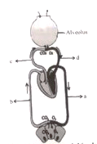
17.
Identify a, b, c and d in the given diagram and choose correct option:
1. (a) is systemic vein and it contain O₂ at higher partial pressure
2. (b) is systemic artery and it contains pCO₂ at higher partial pressure
3. (c) is pulmonary artery and it carries CO₂ rich blood
4. (d) is pulmonary vein and it carries CO₂ at higher partial pressure

Slide 67
18. CO is more toxic than CO₂ because it
1. Damages lungs 2. It destroys haemoglobin
3. Affects the nervous system
4. Reduces the oxygen carrying capacity of haemoglobin
19. Which of the following can respire by moist skin?
1.Sponges and Coelenterates
2. Earthworms and aquatic arthropods
3. Insects and molluscs. 4. Frogs and earthworms.
20. Which set of animals have same respiratory organs?
1. Aquatic arthropods and terrestrial molluscs
2. Sponges and earthworm
3. Reptiles and mammals 4. Amphibians and Insects

Slide 68
21. Which of the following is having the same respiratory organ as in frogs?
1. Mammals 2. Fishes
3. Insects 4. Aquatic molluscs
22. Expiration is result of
1. Contraction of internal intercostal muscles.
2. Relaxation of internal intercostal muscles and diaphragm.
3. Contraction of external intercostal muscles and relaxation of diaphragm.
4. Relaxation of external intercostal muscles and diaphragm
23. After forceful inspiration, the amount of air that can be breathed out by maximum forced expiration is equal to
1. Inspiratory Reserve Volume (IRV) + Expiratory Reserve Volume (ERV) + Tidal Volume (TV) + Residual Volume (RV)
2. IRV + RV + ERV 3. IRV + TV + ERV 4. TV + RV + ERV

Slide 69
24. Consider the following four statements (i-iv) and select the correct option stating which ones are true (T) and which ones are false (F)
(i) Formation of oxyhaemoglobin occurs on alveolar surface.
(ii) During gaseous exchange the gases diffuse from high partial pressure to low partial pressure.
(iii) Carbon dioxide cannot be transported with haemoglobin
(iv) Earthworm respires through parapodia.
25. Select the incorrect statement
1. Spirometer is used for measuring lung volumes
2. Normal breathing rate of human is 12-16/min
3. Tidal volume is 500ml/min
4. Exchange of gases between the blood and tissues occur by diffusion.

Slide 70
26. During expiration, intra-pulmonary pressure
1. Becomes Zero 2. Remains constant
3. Becomes greater than atmospheric pressure
4. Becomes lesser than atmospheric pressure
27. Which of the following would have the same content?
1. Blood entering the lungs and blood leaving the lungs.
2. Blood entering the right side of the heart and blood leaving the right side of the heart
3. Blood entering the right side of the heart and blood leaving the left side of the heart
4. Blood entering the tissue capillaries and blood leaving the tissue capillaries.

Slide 71
28. Incorrect about haemoglobin is
1. It forms a reversible compound with O₂
2. It forms an irreversible compound with CO₂
3. It contains Fe
4. It is found in RBC
29. Carbonic anhydrase enzyme is found in
1. Very low concentration in RBCs and absent in plasma.
2. Very high concentration in RBCs and absent in plasma.
3. Very high concentration in RBCs and very low in plasma
4. Very low concentration in RBCs and very high concentration in plasma.

Slide 72
30. If A, B, C and D are partial pressure of CO₂ in atmosphere, alveoli, exygenated blood and deoxygenated blood, than which relation is correct:
1. A<B=C<D 2. A>B=C>D 3. A<B<C=D 4. A=B<C<D
31. Select the incorrect statement
1. Inner pleural membrane is in contact with thoracic lining
2. External nostrils lead nasal chamber.
3. Ribs form the lateral boundary of thoracic chamber.
4. Exchange of gases in alveoli occurs by simple diffusion.
32. Emphysema is a condition resulting from
1. cigarette smoking 2. Liquor consumption
3. drug addiction 4. Reduced oxygen carrying capacity of blood.

Slide 73
33. Chemosensitive area in medulla is sensitive to
1. H⁺ only 2. CO­₂ only
3. H⁺ and CO₂ both 4. O₂ only
34. Assertion: In normal breathing, inspiration is an active process.
Reason: Inspiration is facilitated by contraction of diaphragm and external intercostal muscles.
1. If both assertion and reason are true and reason is the correct explanation of assertion.
2. If both assertion and reason are true but reason is not the correct explanation of assertion.
3. If assertion is true but reason is false.
4. If assertion is false but reason is true.

Slide 74
35. Assertion: One should always sleep in a closed room with a burning lamp inside.
Reason: When carbon monoxide combines with haemoglobin it form carboxyhaemoglobin.
1. If both assertion and reason are true and reasons is the correct explanation of assertion.
2. If both assertion and reason are true but reason is not the correct explanation of assertion.
3. If assertion is true but reason is false.
4. If assertion is false but reason is true.

Slide 75
36. Statement – I : From external nostrils up to terminal bronchioles constitute the respiratory/exchange part of the respiratory system.
Statement – II : The alveoli and their ducts form the conducting part of the respiratory system.
1. Both Statement – I and Statement – II are correct.
2. Statement – I is correct but Statement – II is incorrect.
3. Statement – I is incorrect but Statement – II is correct.
4. Both Statement – I and Statement – II are incorrect

